Slide 1
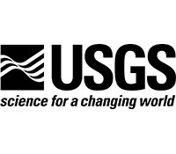
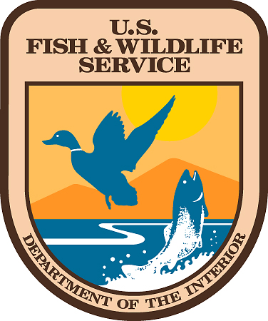
Notice
WATER USE RESTRICTION AREA
In response to an infestation of an aquatic invasive species, the Asian clam (Corbicula fluminea), this area is being treated with sodium hydroxide (NaOH) under non-permeable barriers. NaOH is a chemical that reacts with carbon dioxide to form a non-toxic salt by-product. NaOH (in pellet form, an EPA Registered herbicide & fungicide) will be applied to less than half an acre at this location to control Asian clams under EPA-NPDES Pesticide General Permit IDG87AE24. The area will likely remain under treatment between February 14 and April 15, 2015. NaOH will temporarily raise the pH of the lake bottom under the barrier. Therefore, water use restrictions will be in effect for households utilizing water from the lake that are located up to 1/5 mile from the treated areas for a minimum of 60 days. The treatment is coordinated with Idaho Department of Agriculture, U.S. Fish & Wildlife Service, Idaho Department of Fish & Game, and the University of Idaho. Please refer to the following website for updated information: http://webpages.uidaho.edu/LPOAsianclams/ Contact Bob Kibler, US Fish & Wildlife Service with questions: (208) 378-5255 (Primary contact) –or—Christine Moffitt (208) 885-7047 (Alt)
The following uses are prohibited until pH levels return to normal
Potable Water | Functioning potable water intakes must be turned off
Irrigation | Irrigation intakes should be turned off
Recreation | Includes wading, swimming, fishing, and watercraft use
Animal Consumption | Do not intentionally use water for animal consumption

